Slide 1
Synchronous Sequential Circuit Design
1

Slide 2
Sequential circuit design
In sequential circuit design, we turn some description into a working circuit
  We first make a state table or diagram to express the computation
  Then we can turn that table or diagram into a sequential circuit

Slide 3
Sequential circuit design procedure
Step 1:
Make a state table based on the problem statement. The table should
show the present states, inputs, next states and outputs. (It may be
easier to find a state diagram first, and then convert that to a table)
Step 2:
Assign binary codes to the states in the state table, if you haven’t already. If you have n states, your binary codes will have at least
⎡log₂ n⎤ digits, and your circuit will have at least ⎡log₂ n⎤ flip-flops
Step 3:
For each flip-flop and each row of your state table, find the flip-flop input values that are needed to generate the next state from the present state. You can use flip-flop excitation tables here.
Step 4:
Find simplified equations for the flip-flop inputs and the outputs.
Step 5:
Build the circuit!

Slide 4
Sequence recognizer (Mealy)
A sequence recognizer is a special kind of sequential circuit that looks
for a special bit pattern in some input
The recognizer circuit has only one input, X
  One bit of input is supplied on every clock cycle
  This is an easy way to permit arbitrarily long input sequences
There is one output, Z, which is 1 when the desired pattern is found
Our example will detect the bit pattern “1001”:
Inputs: 1 1 1 0 0 1 1 0 1 0 0 1 0 0 1 1 0 …
Outputs: 0 0 0 0 0 1 0 0 0 0 0 1 0 0 1 0 0 …
A sequential circuit is required because the circuit has to “remember”
the inputs from previous clock cycles, in order to determine whether
or not a match was found

Slide 5
Step 1: Making a state table
The first thing you have to figure out is precisely how the use of state
will help you solve the given problem
  Make a state table based on the problem statement. The table
  should show the present states, inputs, next states and outputs
  Sometimes it is easier to first find a state diagram and then
  convert that to a table
This is usually the most difficult step. Once you have the state table,
the rest of the design procedure is the same for all sequential circuits

Slide 6
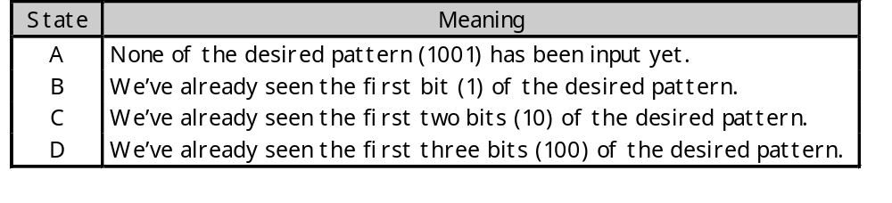
A basic Mealy state diagram
What state do we need for the sequence recognizer?
  We have to “remember” inputs from previous clock cycles
  For example, if the previous three inputs were 100 and the current input is 1, then the output should be 1
  In general, we will have to remember occurrences of parts of the desired pattern—in this case, 1, 10, and 100
We’ll start with a basic state diagram:
1/0
0/0
0/0
A
B
C
D

Slide 7
Overlapping occurrences of the pattern
What happens if we’re in state D (the last three inputs were 100), and
the current input is 1?
  The output should be a 1, because we’ve found the desired pattern
  But this last 1 could also be the start of another occurrence of the pattern! For example, 1001001 contains two occurrences of 1001
  To detect overlapping occurrences of the pattern, the next state
  should be B.
1/0
0/0
0/0
A
B
C
D
1/1

Slide 8
Filling in the other arrows
Two outgoing arrows for each node, to account for the possibilities of
X=0 and X=1
The remaining arrows we need are shown in blue. They also allow for
the correct detection of overlapping occurrences of 1001.
0/0
1/0
1/0
0/0
0/0
A
B
C
D
1/0
0/0
1/1

Slide 9
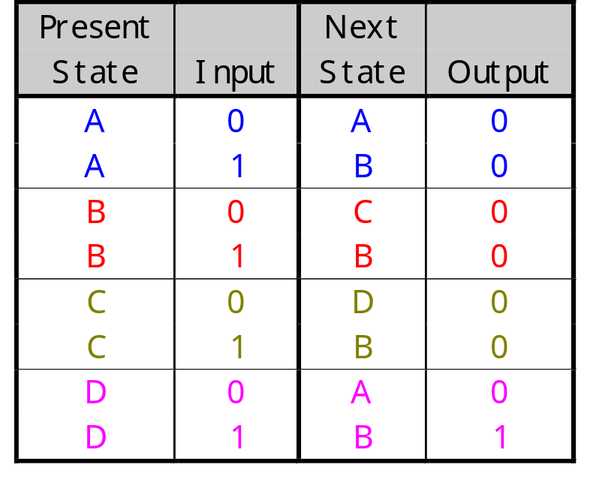
Mealy state diagram & table
0/0
1/0
1/0
0/0
0/0
A
B
C
D
1/0
0/0
1/1

Slide 10
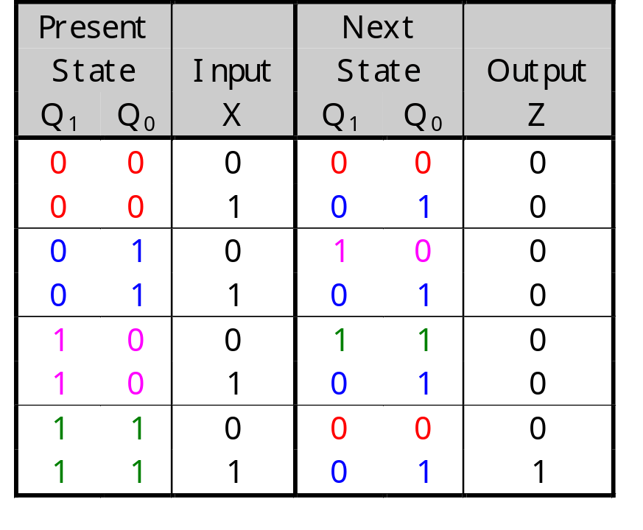
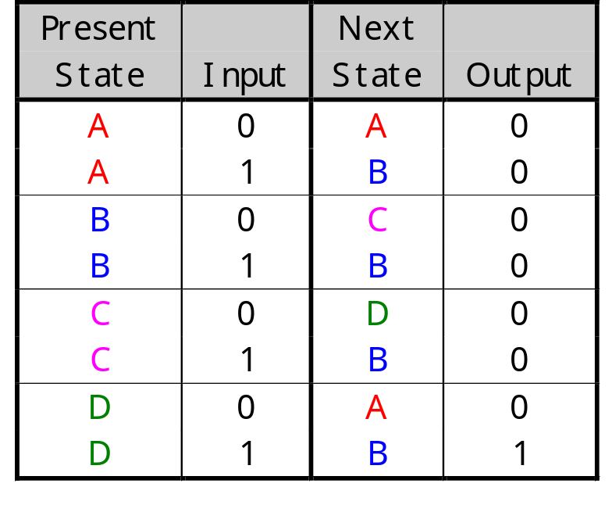
Step 2: Assigning binary codes to states
We have four states ABCD, so we need at least two flip-flops Q₁Q₀
The easiest thing to do is represent state A with Q₁Q₀ = 00, B with 01, C with 10, and D with 11
The state assignment can have a big impact on circuit complexity, but we won’t worry about that too much in this class

Slide 11
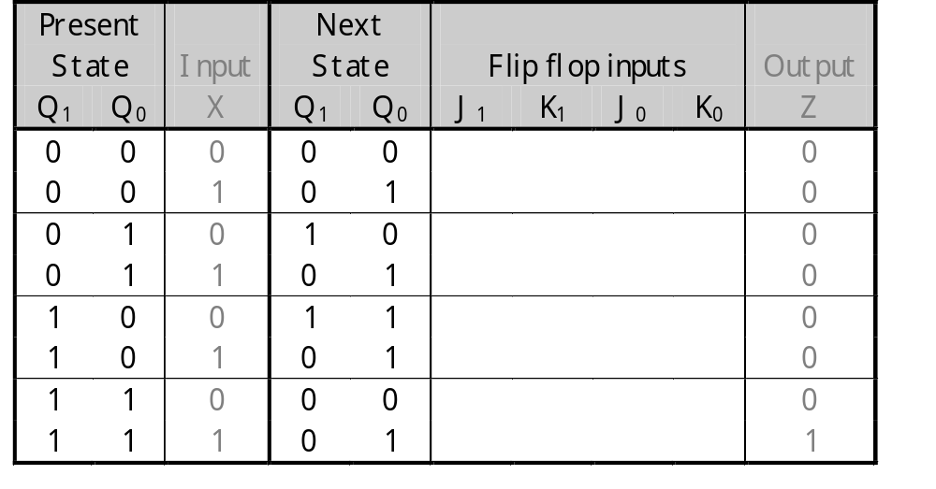
Step 3: Finding flip-flop input values
Next we have to figure out how to actually make the flip-flops change
from their present state into the desired next state
This depends on what kind of flip-flops you use!
We’ll use two JKs. For each flip-flip Q_{i}, look at its present and next states, and determine what the inputs J_{i} and K_{i} should be in order to make that state change.

Slide 12
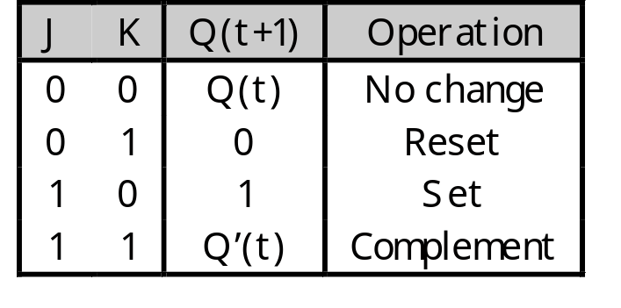
Finding JK flip-flop input values
For JK flip-flops, this is a little tricky. Recall the characteristic table:
If the present state of a JK flip-flop is 0 and we want the next state to be 1, then we have two choices for the JK inputs:
  We can use JK= 10, to explicitly set the flip-flop’s next state to 1
  We can also use JK=11, to complement the current state 0
So to change from 0 to 1, we must set J=1, but K could be either 0 or 1
Similarly, the other possible state transitions can all be done in two
different ways as well

Slide 13
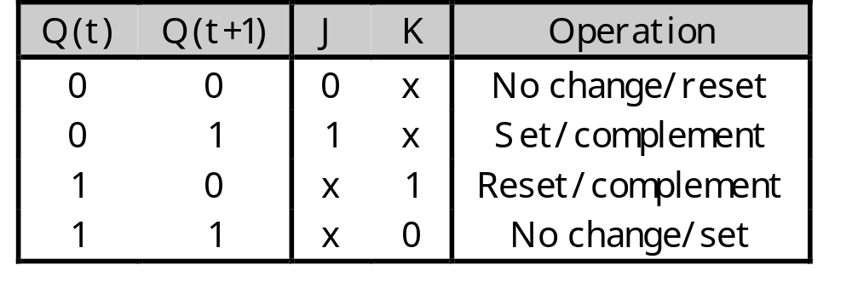
JK excitation table
An excitation table shows what flip-flop inputs are required in order to
make a desired state change
This is the same information that’s given in the characteristic table, but
presented “backwards”

Slide 14
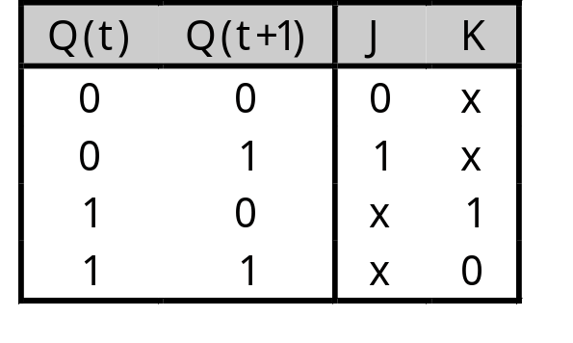
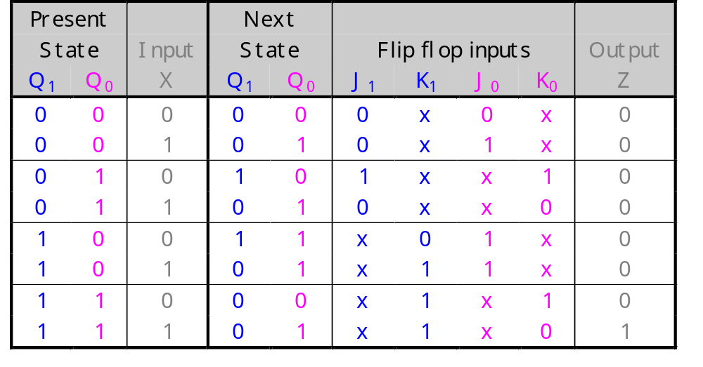
Back to the example
Use the JK excitation table on the right to
find the correct values for each flip-flop’s
inputs, based on its present and next states

Slide 15
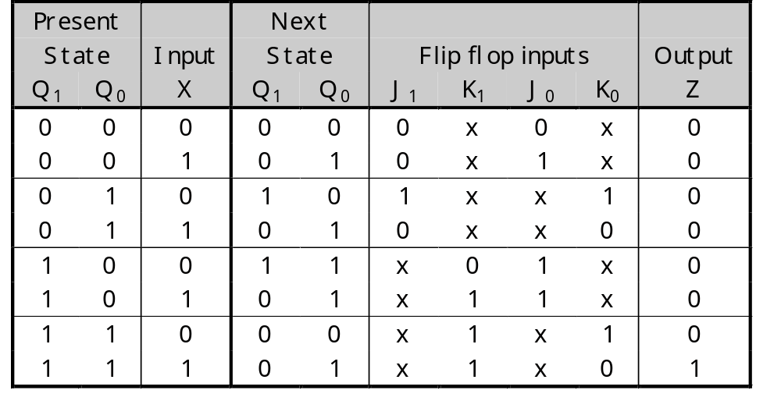
Step 4: Find equations for the FF inputs and output
Now you can make K-maps and find equations for each of the four flip-flop inputs, as well as for the output Z
These equations are in terms of the present state and the inputs
The advantage of using JK flip-flops is that there are many don’t care conditions, which can result in simpler MSP equations

Slide 16
FF input equations
J₁ |  | Q₁ Q₀
 |  | 00 | 01 | 11 | 10
X | 0 | 0 | 1 | x | x
 | 1 | 0 | 0 | x | x
K₁ |  | Q₁ Q₀
 |  | 00 | 01 | 11 | 10
X | 0 | x | x | 1 | 0
 | 1 | x | x | 1 | 1
J₁ = X’ Q₀
K₁ = X + Q₀

Slide 17
FF input equations
J₀ |  | Q₁ Q₀
 |  | 00 | 01 | 11 | 10
X | 0 | 0 | x | x | 1
 | 1 | 1 | x | x | 1
K₀ |  | Q₁ Q₀
 |  | 00 | 01 | 11 | 10
X | 0 | x | 1 | 1 | x
 | 1 | x | 0 | 0 | x
J₀ = X + Q₁
K₀ = X’

Slide 18
Output equation
Z |  | Q₁ Q₀
 |  | 00 | 01 | 11 | 10
X | 0
 | 1 |  |  | 1
Z = X Q₁ Q₀

Slide 19
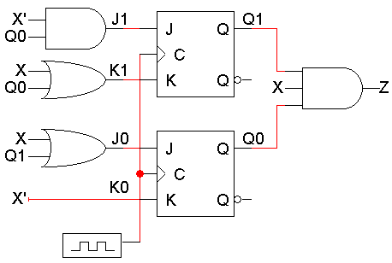
Step 5: Build the circuit
Lastly, we use these simplified equations to build the completed circuit
J₁ = X’ Q₀
K₁ = X + Q₀
J₀ = X + Q₁
K₀ = X’
Z = Q₁Q₀X

Slide 20
Timing diagram
Here is one example timing diagram for our sequence detector
  The flip-flops Q₁Q₀ start in the initial state, 00
  On the first three positive clock edges, X is 1, 0, and 0. These inputs cause Q₁Q₀ to change, so after the third edge Q₁Q₀ = 11
  Then when X=1, Z becomes 1 also, meaning that 1001 was found
The output Z does not have to change at positive clock edges. Instead, it may change whenever X changes, since Z = Q₁Q₀X
1 2 3 4
CLK
Q₁
Q₀
X
Z

Slide 21
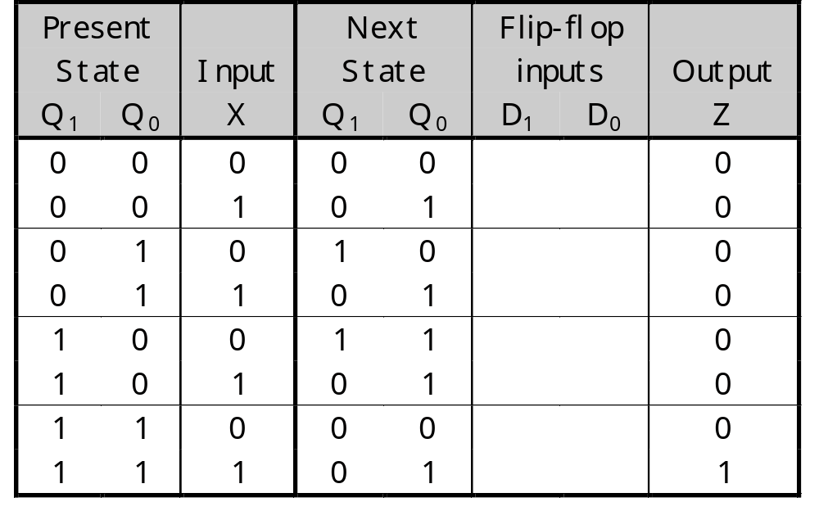
Building the same circuit with D flip-flops
What if you want to build the circuit using D flip-flops instead?
We already have the state table and state assignments, so we can just
start from Step 3, finding the flip-flop input values
D flip-flops have only one input, so our table only needs two columns for
D₁ and D₀

Slide 22
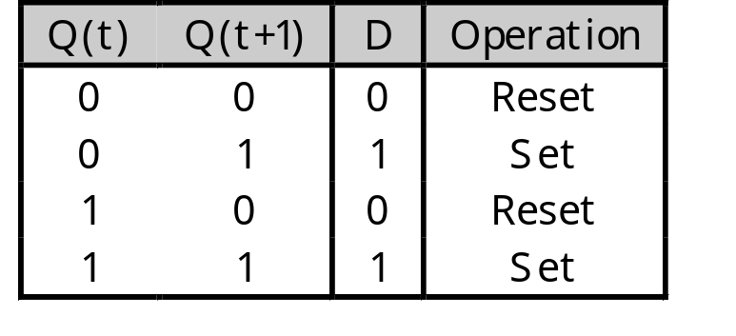
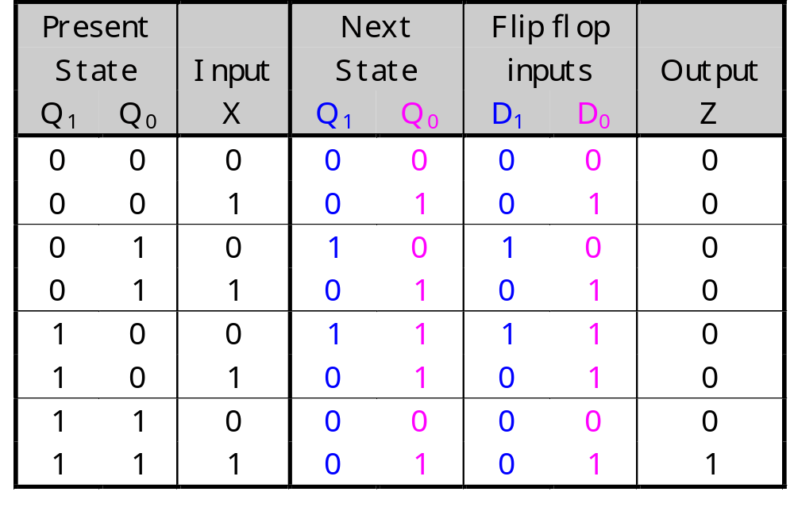
D flip-flop input values (Step 3)
The D excitation table is pretty boring; set the D input to whatever the next state should be
You don’t even need to show separate columns for D₁ and D₀; you can just use the Next State columns

Slide 23
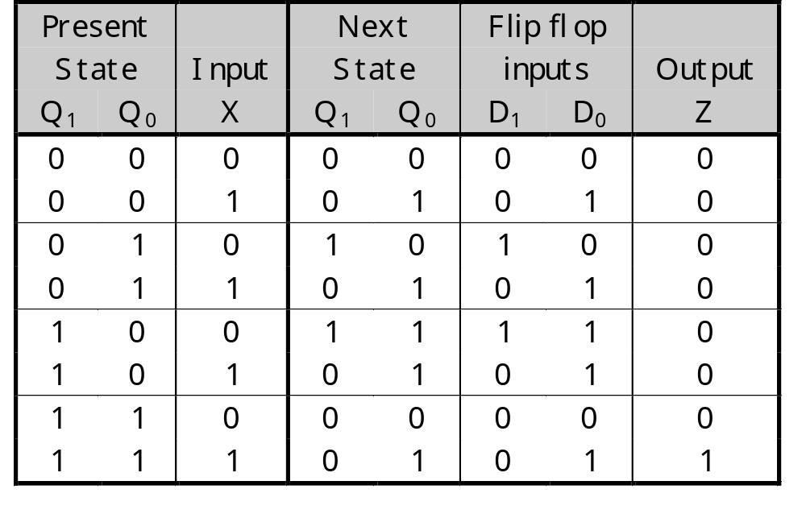
Finding equations (Step 4)
D₁ |  | Q₁ Q₀
 |  | 00 | 01 | 11 | 10
X | 0 |  | 1 |  | 1
 | 1
D₀ |  | Q₁ Q₀
 |  | 00 | 01 | 11 | 10
X | 0 |  |  |  | 1
 | 1 | 1 | 1 | 1 | 1
Z |  | Q₁ Q₀
 |  | 00 | 01 | 11 | 10
X | 0
 | 1 |  |  | 1
D₁ = Q₁ Q₀’ X’ + Q₁’ Q₀ X’
D₀ = X + Q₁ Q₀’
Z = X Q₁ Q₀

Slide 24
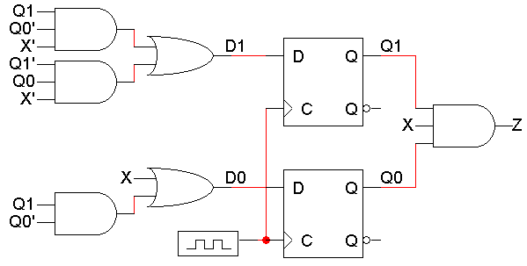
Building the circuit (Step 5)

Slide 25
Sequence recognizer (Moore)
A sequence recognizer is a special kind of sequential circuit that looks
for a special bit pattern in some input
The recognizer circuit has only one input, X
  One bit of input is supplied on every clock cycle
  This is an easy way to permit arbitrarily long input sequences
There is one output, Z, which is 1 when the desired pattern is found
Our example will detect the bit pattern “1001”:
Inputs: 1 1 1 0 0 1 1 0 1 0 0 1 0 0 1 1 0 …
Outputs: 0 0 0 0 0 1 0 0 0 0 0 1 0 0 1 0 0 …
A sequential circuit is required because the circuit has to “remember”
the inputs from previous clock cycles, in order to determine whether
or not a match was found

Slide 26
Moore state diagram & table
0
1
1
0
0
1
A/0
B/0
C/0
D/0
E/1
1
0
0
1
Present
Next
State
Input
State
Output
Z |  | Q₂ Q₁
 |  | 00 | 01 | 11 | 10
Q₀ | 0
 | 1 |  |  |  | 1
A
0
A
0
A
1
B
0
A: 000 D: 100
B: 001 E: 101
C: 010
B
0
C
0
B
1
B
0
C
0
D
0
C
1
B
0
Z= Q₂ Q₁’ Q₀
D
0
A
0
D
1
E
0
E
0
C
1
E
1
B
1

Slide 27
Vending Machine
Design a vending machine which meets the following specs:
  Deliver a package of gum after 15 cents deposited
  Single coin slot for dimes, nickels
    N =1 => A nickel is deposited
    D =1 => A dime is deposited
  No change
N
Coin
Vending
Gum
Sensor
D
Z
Machine
Release
SSC
Mechanism
Clk
Block Diagram of the System

Slide 28
Vending Machine
00
00/0
0
Z=0
0
01
01/0
10
10/1
00
5
Z=0
10/0
01/1
00/0
5
00
00
01
10/1
10
01/0
01
10
Z=0
00
10
10
01
10
00/0
15
Z=1
01
10
Mealy Model
Moore Model
20
Z=1

Slide 29
Traffic Light Controller
  A busy highway is intersected by a little used farmroad. Detectors
  C sense the presence of cars waiting on the farmroad. With no car
  on farmroad, light remain green in highway direction. If vehicle on
  farmroad, highway lights go from Green to Yellow to Red, allowing
  the farmroad lights to become green. These stay green only as long
  as a farmroad car is detected but never longer than a set interval.
  When these are met, farm lights transition from Green to Yellow to
  Red, allowing highway to return to green. Even if farmroad vehicles
  are waiting, highway gets at least a set interval as green.
  Assume you have an interval timer that generates a short time pulse
  (TS) and a long time pulse (TL) in response to a set (ST) signal. TS
  is to be used for timing yellow lights and TL for green lights.
  Note: The interval timer is just another sequential circuit!

Slide 30
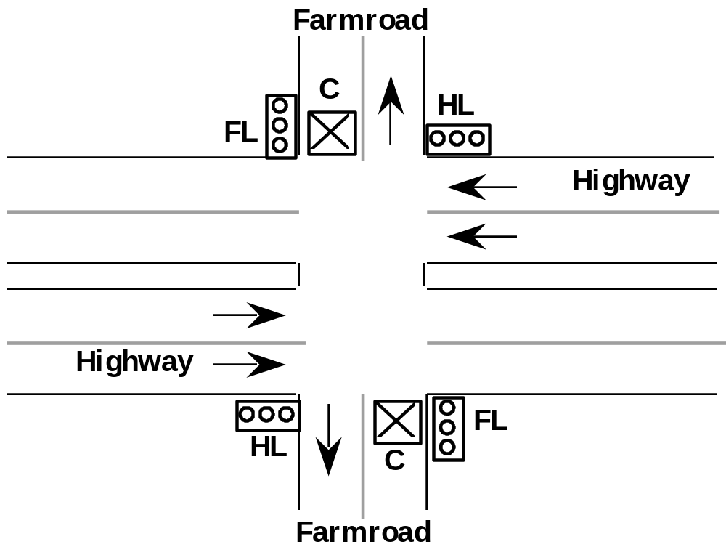
Traffic Light Controller

Slide 31
Traffic Light Controller
Input Signals
C | detect vehicle on farmroad
TS | short time interval expired
TL | long time interval expired
Output Signals
HG, HY, HR | assert green/yellow/red highway lights
FG, FY, FR | assert green/yellow/red farmroad lights
ST | start timing a short or long interval
State
S0 | Highway green (farmroad red)
S1 | Highway yellow (farmroad red)
S2 | Farmroad green (highway red)
S3 | Farmroad yellow (highway red)

Slide 32
Traffic Light Controller
x,0,x
0,1,x
C,TL,TS/ST
S0
HG=1
FR=1
1,1,x/1
x,x,1/1
S1
S3
HY=1
FR=1
HR=1
FY=1
x,x,0
x,x,0
x,x,1/1
x,1,x/1
0,0,x/1
S2
HR=1
FG=1
Note: This sequential circuit has both Mealy and Moore outputs!
1,0,x

Slide 33
Digital Combination Lock
"3 bit serial lock controls entry to locked room. Inputs are RESET,
ENTER, 2 position switch for bit of key data. Locks generates an
UNLOCK signal when key matches internal combination. ERROR
light illuminated if key does not match combination.
Sequence is:
(1) Press RESET, (2) enter key bit, (3) Press ENTER,
(4) repeat (2) &(3) two more times."
Problem specification is incomplete:
• how do you set the internal combination?
• exactly when is the ERROR light asserted?
Make reasonable assumptions:
• hardwired into next state logic vs. stored in internal register
• assert as soon as error is detected vs. wait until full
combination has been entered
Our design: registered combination plus error after full combination

Slide 34
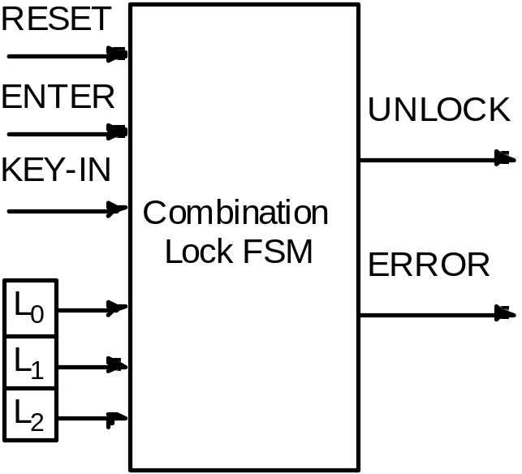
Digital Combination Lock
Operator Data
Internal
Combination
Inputs:
Reset
Enter
Key-In
L0, L1, L2
Outputs:
Unlock
Error

Slide 35
Digital Combination Lock
Note that each key entry is really a two-step process
1. Wait for the enter key
2. Check if correct key was selected
Si
Enter=‘0’
Enter=‘1’
Sj
KI ≠ Li
KI = Li
Check
next key
To error
sequence

Slide 36
Digital Combination Lock
Reset + Enter
Reset
Start
Reset • Enter
Comp0
KI = L0
KI ° L0
Enter
Enter
Idle0
Idle0'
Enter
Enter
Comp1
Error1
KI = L1
KI ° L1
Enter
Enter
Idle1
Idle1'
Enter
Enter
Comp2
Error2
KI = L2
KI ° L2
Reset
Done
Error3
Reset
[Unlock]
[Error]
Reset
Reset

Slide 37
Summary
The basic sequential circuit design procedure:
  Make a state table and, if desired, a state diagram. This step is usually the hardest
  Assign binary codes to the states if you didn’t already
  Use the present states, next states, and flip-flop excitation tables to find the flip-flop input values
  Write simplified equations for the flip-flop inputs and outputs and build the circuit

